Slide 1
Introduction to Python - Part 1
Women’s Data Science Study Group
Presenter: Soane Mota
Meeting #18

Slide 2
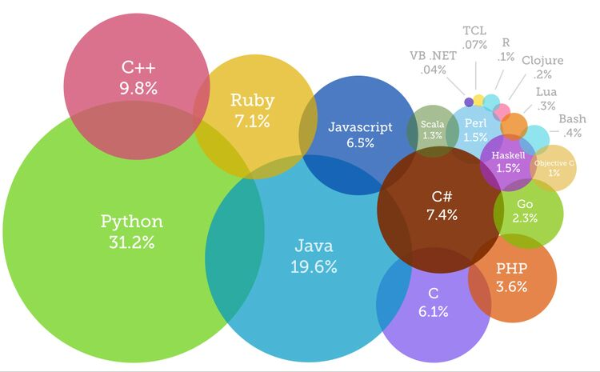
Most Popular Programming Languages of 2019
Source: https://www.devsaran.com/blog/10-best-programming-languages-2019-you-should-know

Slide 3
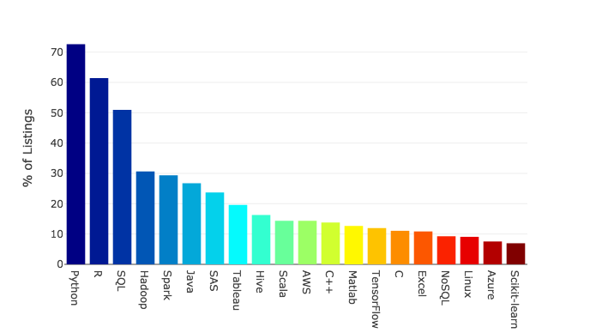
Top 20 Technology Skills in Data Science Job Listings in 2018
Source: https://towardsdatascience.com/the-most-in-demand-skills-for-data-scientists-4a4a8db896db
Notes:
The 2018 survey searched job listings on LinkedIn, Indeed, SimplyHired, and Monster in the US

Slide 4

Python
Most popular language for ML​
Open source​
Versions 2.7, 3.6, or 3.7?​
Find basically any solution online (Google, Stack Overflow)​
Better dealing with big data​
Perfect for deep learning and GPU processing​
Jupyter Notebook

Slide 5
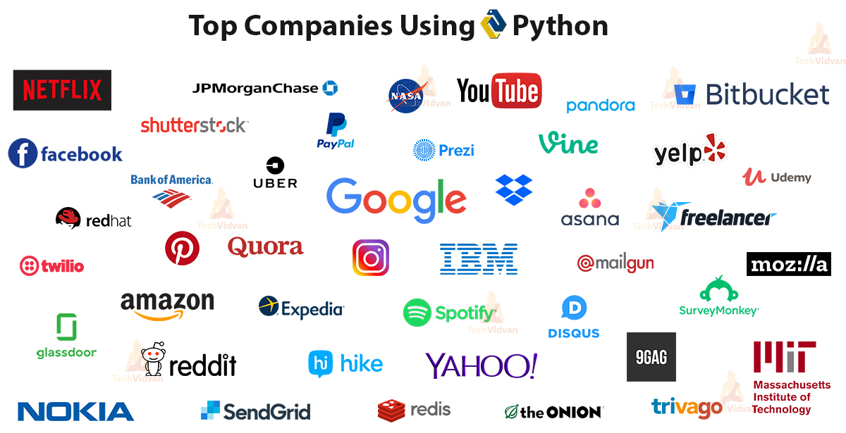
Source: https://techvidvan.com/tutorials/python-tutorial/

Slide 6
Python Applications
Python is everywhere. There is nothing you can’t do with it. Let’s take a quick look at where it finds use.
Scripting – Python is great for server-side and other scripting
Data Science
Machine Learning
Artificial Intelligence
GUI and Game development
Web development
Computer Vision (CV)/ Image manipulation
Robotics
Web Scraping
Network Programming
Numeric and Scientific Computing
Enterprise applications
Source: https://techvidvan.com/tutorials/python-tutorial/

Slide 7
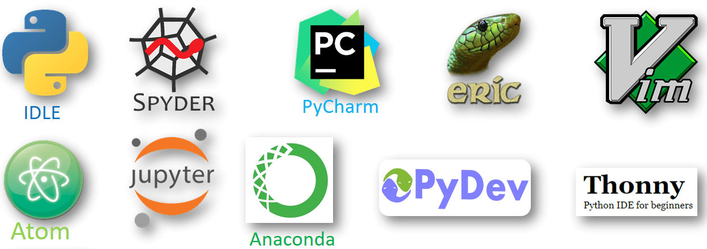
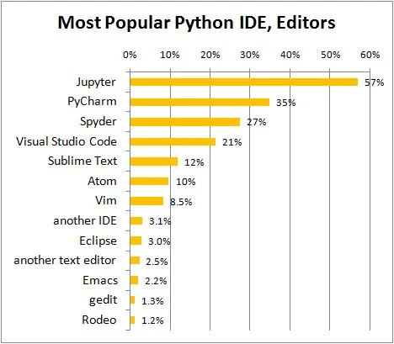
Most Popular Python IDE in December 2018
Specific for python programming:
Jupyter
PyCharm
Spyder
Visual Studio Code
Rodeo
Text editor to run in a terminal
Sublime Text
Atom
Vim (better on linux)
Emacs (better on linux)
gedit (better on linux)
Source: https://www.datacamp.com/community/tutorials/top-python-ides-for-2019
Notes:
IDE: Integrated Development Environment

Slide 8
Jupyter Notebook

Slide 9
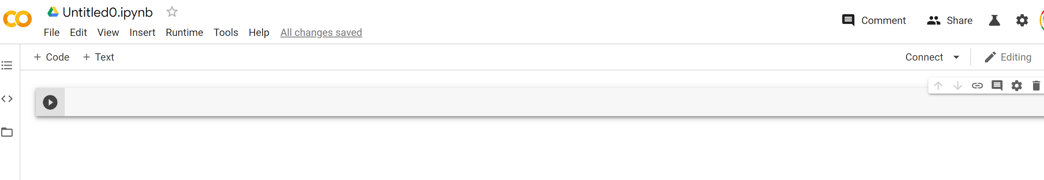
Google Colab
Colaboratory is a free Jupyter notebook environment that requires no setup and runs entirely in the cloud.
With Colaboratory you can write and execute code, save and share your analyses, and access powerful computing resources, all for free from your browser.
https://colab.research.google.com/notebooks/welcome.ipynb

Slide 10
Now, it is coding time!!!

